Slide 1
College Basketball Model
John Paul Schiele

Slide 2
Data Collection
Data Scraping from https://www.sports-reference.com/
Stored all individual game data in Firestore Database
Limited in number of HTTP calls
Used call timer
Located game table within HTML and stripped unnecessary rows and columns
Stored game data under conference/team/year/game-log
Game data from 2018-2023
Notes:
teamCollection.py

Slide 3
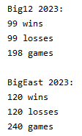
Data Checks
Checked total wins and losses counts for every conference in each year
Standardized team naming conventions
Matches names found on https://www.sports-reference.com/
Notes:
gameCount.py and edits

Slide 4
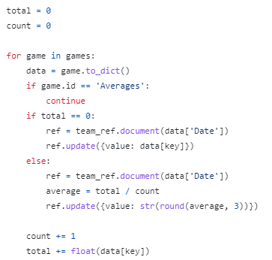
Getting Averages
A team’s average for a statistic over the course of a season is very important in predicting outcomes and scores
Team construction changes drastically each year in college
Used previous games to not influence the model
Notes:
averages.py

Slide 5
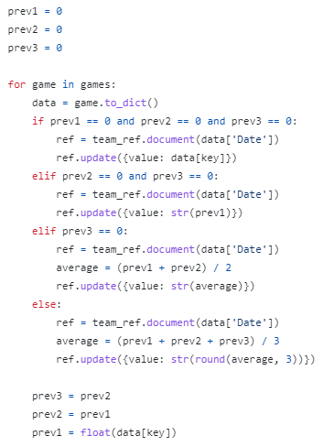
Getting Recent Averages
Getting a team’s average for a statistic in their last three games gives a good idea of how a team has been doing lately
Can be influenced by injuries and momentum
Used the previous three games to calculate an average
Notes:
L3averages.py

Slide 6
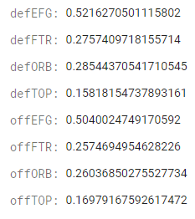
Efficiency Ratings
There are eight main efficiency ratings used in basketball that help determine game outcomes
Offensive/Defensive effective FG%
Offensive/Defensive TO%
Offensive/Defensive OR%
Offensive/Defensive FTR
Individual game efficiency ratings and season averages are stored in database
Notes:
efficiency.py and efficiencyAVG.py

Slide 7
Effective FG%
Formula: (Field Goals Made + 0.5 * 3 Pointers Made) / Field Goals Attempted
Gives a better understanding of the ratio between 2 point and 3 point field goals a team makes on offense and allows on defense

Slide 8
Turnover Percentage
Formula: Turnovers / Possessions
Gives a better understanding for the turnovers committed and forced by each team

Slide 9
Offensive Rebound Percentage
Formula: Offensive Rebounds / (Offensive Rebounds + Opp Defensive Rebounds)
Gives a better understanding of how good a team is at getting offensive rebounds and giving up offensive rebounds

Slide 10

Free Throw Rate
Formula: Free Throw Attempts / Field Goal Attempts
Gives a better understanding of how efficient a team is at getting to the free throw line and how often they allow opponents to get to the free throw line

Slide 11
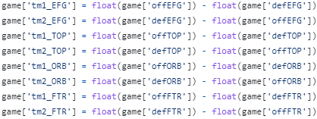
Efficiency in the Model
To train the model and predict outcomes, there must be an equal number of features used when training as there are when predicting
Each game had eight efficiency ratings so I could only use those eight when training the model
I wanted to use the eight ratings for each team when predicting outcomes
Subtracting the ratings allowed me to factor in the eight ratings for each team within the eight features I could use

Slide 12
Finding Features
Using the sklearn feature_selection package I could find the five columns that had the most influence on the predicted outcomes
I used the five columns as well as their five counterparts
I included the place of the game to allow for home and away teams or neutral sites
I included the eight efficiency ratings
Notes:
columnSelection.py

Slide 13

Features
The final list of features used in the models:

Slide 14
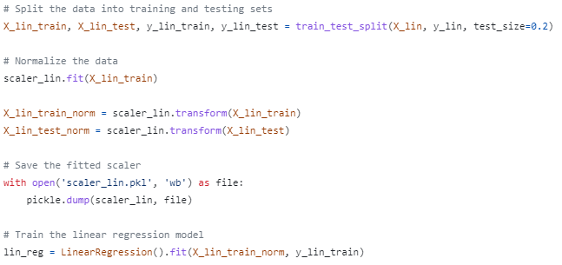
Linear Regression Model
The linear regression algorithm in the sklearn package uses features to find the best fitting linear relationship between the input features and the target variable
Used to predict the score of a game
Split the test and training data 80%-20%
Normalized the data and saved the scaler for future use using pickle
Trained the model using the normalized data
Notes:
Model.py

Slide 15
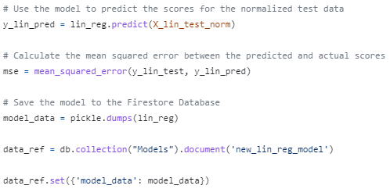
Linear Regression Model
Used the model to predict scores for the normalized test data and calculated the mean squared error between the predicted and actual scores
MSE: Sum of all differences between predicted score and actual scores squared then divided by the number of games minus one
Saved the model to the database for future use using pickle
Original MSE: 184.09
Current MSE: 102.65

Slide 16
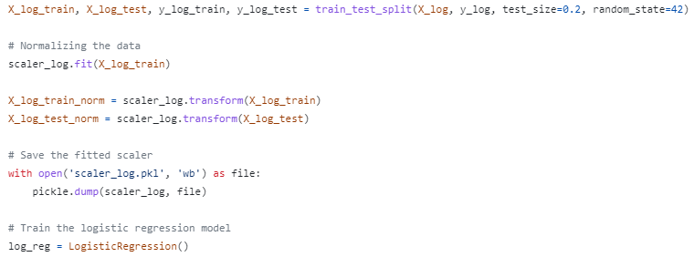
Logistic Regression Model
The logistic regression algorithm in the sklearn package uses features to find the probability of a specified event occurring
Used to predict the win probability for a team
Split the test and training data 80%-20%
Normalized the data and saved the scaler for future use using pickle
Trained the model using the normalized data
Notes:
Model.py

Slide 17
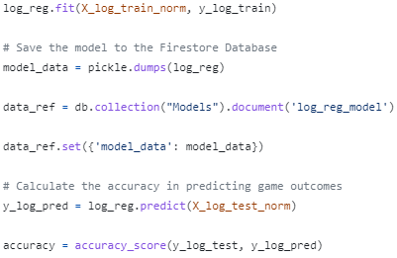
Logistic Regression Model
Used the model to predict win probability for the normalized test data and calculated the accuracy
Accuracy: percentage of outcomes correctly predicted
Saved the model to the database for future use using pickle
Original Accuracy: 75.72%
Current Accuracy: 92.45%

Slide 18
Graphical User Interface
Created a GUI to display the results for game predictions
Conference dropdown to specify a conference
Team dropdowns to choose teams from that conference
Buttons to predict scores or calculate win probability
Notes:
userInterface.py and runModel.py

Slide 19
Results
Used models to predict win probability and scores for the 70 major conference tournament games played in 2023
Using Logistic Regression Model for Win Probability: 60 - 10 (85.7% success rate)
Using Linear Regression to predict Scores:
I decided to use sports betting spreads to judge.
Final Record: 41-28-1 for a return of 10.2 units and a ROI of 14.57%

